Slide 1
Kick-off Year 1C
Modelling

Slide 2
Table of Contents
Creative Brief
Today we start with…

Slide 3
Idea Generation
Open Microsoft Teams
Open your assignment
Open the Project Proposal Template
Go to slide 4: AI- Canvas
Open use-case 3 for responsible & explainable AI
For extra info & further specifications
0. Now, take browse through the Imsitu dataset and select a two classes of pictures your algorithm is going to distinguish between.

Slide 4
Something on Imsitu dataset?

Slide 5
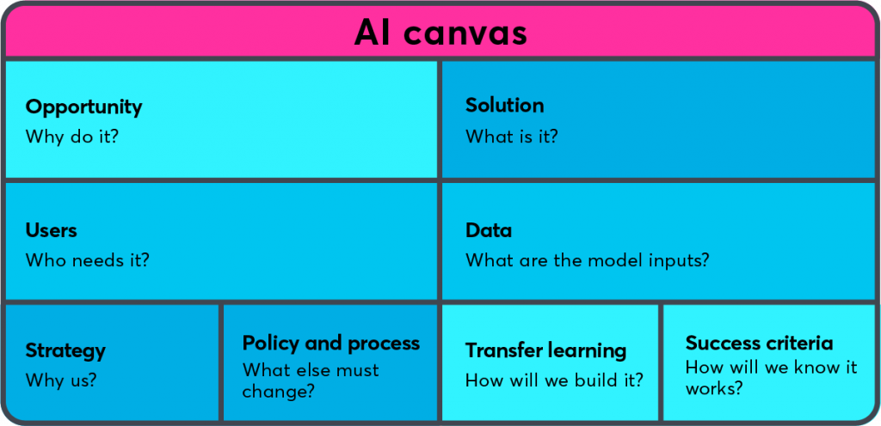
Idea Generation
Opportunity: Define your problem!
What problem is your algorithm going to solve?
Clearly define your problem statement in max 100 words! You can also only just use one word too; e.g. hunger.
Difficulty defining your problem?
go back to step 0. and select some
other pictures

Slide 6
Idea Generation
Diverge with multiple solutions!
Come up with 3 solutions at least! You can come up with as many as you like, just make sure you have at least 3! Motivate you solution by at least answering the following questions:
What could solve your problem?
How is it going to solve your problem?
Why is it feasible?
What are the requirements for this solution to work?

Slide 7
Idea Generation
Converge on best solution!
By answering the following questions:
Which solution do you think is best?
Why do you think it's the best solution?
How well do you think it solves the problem? Define this in a percentage and motivate your answer; a motivated guess is the best we can do right now!
List your chosen solution in the AI-Canvas

Slide 8
Something else?

Slide 9
That’s all folks
We’re going to continually iterate on our AI-canvas during the block.
On Friday we’ll continue iterating on our ideas by doing a market research and creating a persona which is going to use our app.

